Slide 1

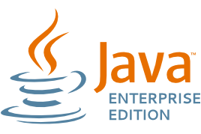

Java EE Basics
Java EE Basics
Application servers and JEE containers
Eclipse
Java EE
Basics
Georgi Novakov
Develop Soft CEO
Software University
http://softuni.bg

Slide 2


Table of Contents
ENTERPRISE SYSTEMS ESSENTIALS
BEFORE AND AFTER JEE
JAVA APPLICATIONS TYPES
JEE CONTAINERS
SERVICES
APPLICATION SERVERS
PACKAGING
ANNOTATIONS AND DESCRIPTORS
SETUP JAVA EE ENVIRONMENT IN PRACTICE

Slide 3
Differences between Java EE and Java SE
Java technology is both a programming language and a platform
The Java Programming Language Platforms
Java Platform, Standard Edition (Java SE)
Java Platform, Enterprise Edition (Java EE)
Java Platform, Micro Edition (Java ME)
JavaFX
Notes:
1. Java technology is both a programming language and a platform. The Java programming language is a high-level object-oriented language that has a particular syntax and style. A Java platform is a particular environment in which Java programming language applications run.
All Java platforms consist of a Java Virtual Machine (VM) and an application programming interface (API). The Java Virtual Machine is a program, for a particular hardware and software platform, that runs Java technology applications. An API is a collection of software components that you can use to create other software components or applications. Each Java platform provides a virtual machine and an API, and this allows applications written for that platform to run on any compatible system with all the advantages of the Java programming language: platform-independence, power, stability, ease-of-development, and security.
Java SE
When most people think of the Java programming language, they think of the Java SE API. Java SE's API provides the core functionality of the Java programming language. It defines everything from the basic types and objects of the Java programming language to high-level classes that are used for networking, security, database access, graphical user interface (GUI) development, and XML parsing.
In addition to the core API, the Java SE platform consists of a virtual machine, development tools, deployment technologies, and other class libraries and toolkits commonly used in Java technology applications.
Java EE
The Java EE platform is built on top of the Java SE platform. The Java EE platform provides an API and runtime environment for developing and running large-scale, multi-tiered, scalable, reliable, and secure network applications.
Java ME
The Java ME platform provides an API and a small-footprint virtual machine for running Java programming language applications on small devices, like mobile phones. The API is a subset of the Java SE API, along with special class libraries useful for small device application development. Java ME applications are often clients of Java EE platform services.
JavaFX
JavaFX is a platform for creating rich internet applications using a lightweight user-interface API. JavaFX applications use hardware-accelerated graphics and media engines to take advantage of higher-performance clients and a modern look-and-feel as well as high-level APIs for connecting to networked data sources. JavaFX applications may be clients of Java EE platform services.

Slide 4
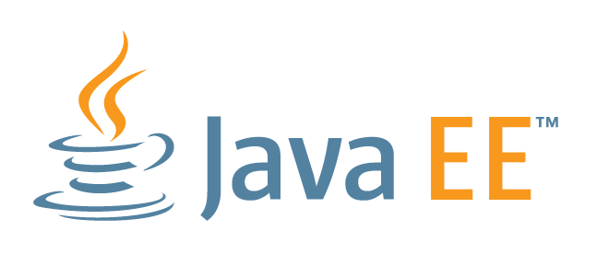
What exactly is the JEE/J2EE?
Open and standard based platform for
developing, deploying and managing
n-tier, Web-enabled and component-based enterprise applications
Solves common
development
problems

Slide 5
Enterprise Systems Essentials
Large scale and complex systems
n number or tiers
Distributed
Thousands of users
Multithreading
Thousands or millions of requests per hour
Support for fail-over
Support for transactions
Support for security
Notes:
Imagine building a big enterprise application from scratch

Slide 6
Before JEE
Developer had to do everything
Care about multithreading
Care about transactions
Care about fail-over
Care about security
... on top of that care about the business logic

Slide 7
After JEE
Application Server/Container takes care of application details
Multithreading
Security
Fail-over
etc.
Developer takes care of configuring the container and writing business logic

Slide 8
Java Applications types
Applets – GUI based components , executes through a web browser;
Desktop applications – executed at client side, graphical or console based;
Web Applications - executed through a web browser and responding to HTTP requests;
Enterprise applications – Executed in an Enterprise container. In most cases contain a web application inside.

Slide 9
JEE Containers
JEE infrastructure is separated into logical areas called containers
Each container supports different set of APIs (security, database access, transaction handling, naming directory, resource injection).
Notes:
Applet контейнер – уеб браузъри
Client application container – библиотеки и JRE
уеб контейнер (сървлети, JSP, filters, listeners, JSF) – apache tomcat, jetty
EJB контейнер – Oracle WebLogic, IBM Websphere, JBoss.

Slide 10
Application Servers
All of application servers provide their own services (JMS, JNDI, servlet containers, etc)‏
Oracle WebLogic (used to be Bea Weblogic)
Oracle Application Server
IBM WebSphere
Jboss/Wildfly (free and open source, but you pay for support)‏
Glassfish
Tomcat – NOT an Enterprise container, only web container

Slide 11
Services
Containers provide predefined services like:
Java Transaction API (JTA) – transactions support
Java Persistence API (JPA) – database access
Java Message Service (JMS) – asynchronous message processing through queues
Java Naming and Directory interface (JNDA) – objects access by name
Java authentication and authorization services (JAAS) - security
Dependency Injection services
JavaMail, XML Processing, JSON Processing, SOAP and REST web services, management and deployment services

Slide 12
JEE application
Servlets - Java objects that extend the functionality of a web server
Run on the server, Require a servlet container to run in, Platform and server independent
JSP - create dynamic web content
HTML/XML/WML/etc with Java code embedded into it
Runs on the server, Platform and server independent, Needs to be pre-compiled into a servlet
EJB - The cornerstone of a JEE application
Session beans
Entity beans
Message-driven beans

Slide 13
Annotations and descriptors
How to tell the container that a class, method or a variable must be treated in a specific way?
Annotations begin with @ and are above class, method or variable
Deployment descriptors are XML files, containing meta data
Annotations VS Descriptors

Slide 14
Annotations and descriptors

Slide 15
Packaging
Strictly specified packaging:
Additional classes and libraries packed in JAR files
Web applications with their classes and libraries packed in WAR files
Enterprise applications packed in EAR files
Notes:
Show example

Slide 16
Setup Java EE Environment in practice
Make sure Java 8 is installed and is in OS Path
Unzip and start Eclipse
Unzip WildFly and Import into Eclipse (Add Jboss Tools)
Start WildFly within Eclipse
Create sample Java EE project and start it

Slide 17
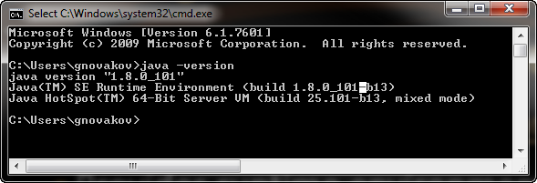
Installing Java
Download and install Java 8 SDK (JDK 8)
http://oracle.com/technetwork/java/javase/downloads/
JAVA_HOME and PATH

Slide 18
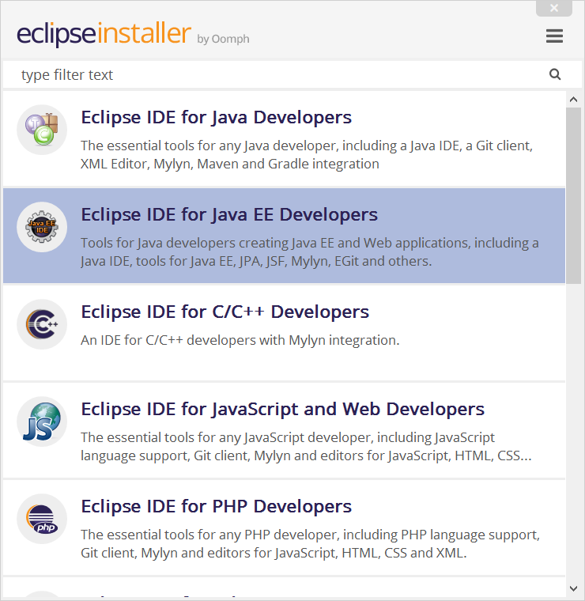
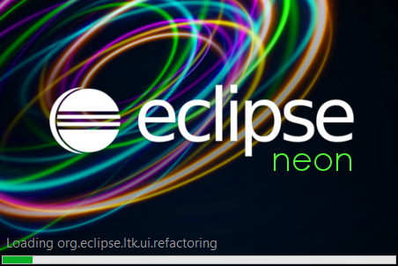
Eclipse for Java EE
Eclipse is open-source Java / Java EE / PHP / C++ IDE
https://www.eclipse.org/downloads/eclipse-packages
Install Eclipse for Java EE /
Notes:
Eclipse alternatives
Why Eclipse JEE

Slide 19
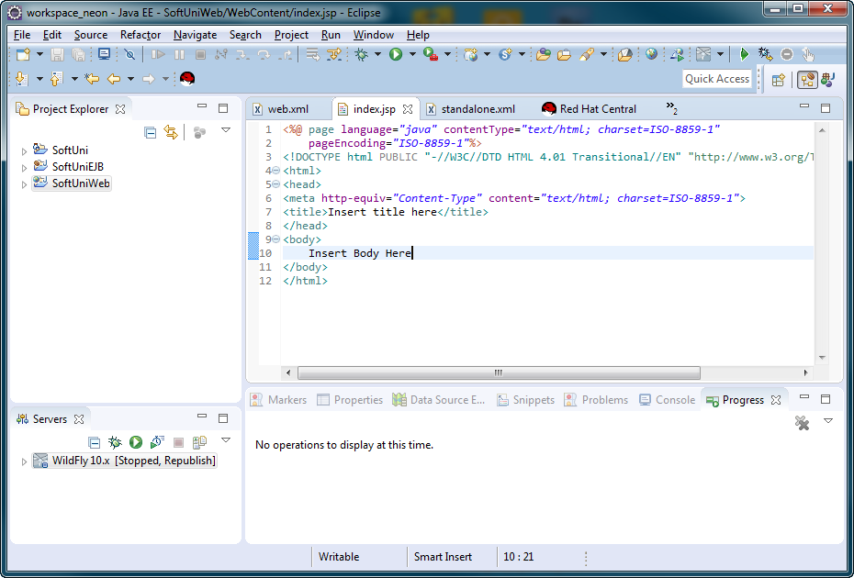
Eclipse for Java EE
Perspectives
Open files
Project Explorer
Additional Tools
Servers

Slide 20
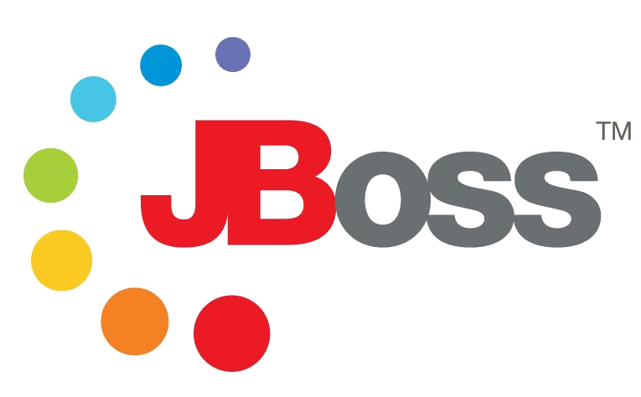

WildFly (Jboss AS)
WildFly is free Java EE server
http://wildfly.org/downloads/ (Java EE7 Full & Web Distribution)
After Jboss 7

Slide 21






Free Trainings @ Software University
Software University Foundation – softuni.org
Software University – High-Quality Education, Profession and Job for Software Developers
softuni.bg
Software University @ Facebook
facebook.com/SoftwareUniversity
Software University @ YouTube
youtube.com/SoftwareUniversity
Software University Forums – forum.softuni.bg

